Slide 1
Cambridge IGCSE Computer Science 0478
Two exam papers. Both non-calculator
Paper 1 – Theory –
Computer Systems - 1hour 45min – 75 marks – 50% of total
Paper 2 – Programming –
Algorithms, Programming and Logic - 1hour 45min – 75 marks – 50% of total
Year 10 will mainly teach theory
Year 11 will mainly teach programming
WeChat: Amar-Anwar
Email: Amar.Anwar@yinghua-school.com
Email: Amar.Anwar@tjyh2003.com

Slide 2
1.1 Number systems
Understand how and why computers use binary to represent all forms of data
Understand the denary, binary and hexadecimal number systems
Convert between
positive denary and positive binary
positive denary and positive hexadecimal
positive hexadecimal and positive binary
Understand how and why hexadecimal is used as a beneficial method of data representation
Add two positive 8-bit binary integers
Understand the concept of overflow and why it occurs in binary addition
Perform a logical binary shift on a positive 8-bit binary integer and understand the effect this has on the positive binary integer
Use two’s complement to represent positive and negative 8-bit binary integers

Slide 3
Today
Understand how and why computers use binary to represent all forms of data
Understand the denary, binary and hexadecimal number systems
Convert between
positive denary and positive binary
positive denary and positive hexadecimal
positive hexadecimal and positive binary
Understand how and why hexadecimal is used as a beneficial method of data representation
Understand: What are number systems
Able: Convert between number systems
Answer: Why do we use Hex?

Slide 4
Task:
Count the first 10 numbers:
0 1 2 3 4 5 6 7 8 9
This is called the decimal or denary number system
It’s a base 10 number system as there are 10 numbers in it.

Slide 5
Question:
A computer’s number system is a base 2 number system – why?
A computer uses only two numbers:
0 and 1 – this number system is called binary

Slide 6
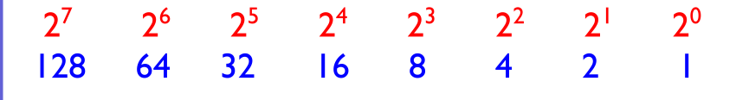
Convert denary 25 into binary
0 0 0 1 1 0 0 1

Slide 7
Convert denary 69 into binary
0 1 0 0 0 1 0 1

Slide 8
Convert 10110001 into base 10
1 0 1 1 0 0 0 1
128+32+16+1 = 177

Slide 9
Convert 01010101 into denary
0 1 0 1 0 1 0 1
64+16+4+1= 85

Slide 10
Your phone
How much space does your phone have?
Mines 64GB
But what’s a Gigabyte?

Slide 11
Bits and Bytes
1 bit = 1 binary digit = the smallest thing you can have
1 byte = 8 bits
1 kilobyte = 1024 bytes
1 megabyte = 1024 kilobytes
1 gigabyte = 1024 megabytes
…
Bit > Byte > Kilobyte > Megabyte > Gigabyte > Terabyte > Petabytes > Exabyte > Zettabyte > Yottabytes > Brontobyte > Geopbyte

Slide 12
Calculate
1MB in bytes
32GB in bits
1024GB in TB
1024GB in MB
9 bytes in bits
19384932 bytes in bits
38288732 bits in bytes

Slide 13
Register
A register is a group of bits.
(A bit is one binary digit)
You show a register by drawing a grid
This is a 2-bit register
0 | 1

Slide 14
Registers
What would you call this register?
This is an 8-bit register
0 | 1 | 1 | 0 | 0 | 1 | 1 | 1

Slide 15
Control systems
Registers are used in control systems
A control system is just the name we use when you want a computer to control something
Robots
Security systems
Home automation
These are all control systems

Slide 16
Control System
Let’s look at security for your house
Using the above register as a control system.
01100111 will:
Turn the kitchen light ON
Turn the kitchen camera OFF
Turn the Alarm ON
Call my Phone
Call the Police
0 | 1 | 1 | 0 | 0 | 1 | 1 | 1
Kitchen Light OFF | Kitchen Light ON | Kitchen Camera OFF | Kitchen Camera ON | Alarm OFF | Alarm ON | Call my Phone | Call Police

Slide 17
Create your register
Create your register so it:
Turn off everything apart from the alarm and call the police
Turn on everything in the kitchen
Turn on the light and camera only
Call the police when the camera is on
Kitchen Light OFF | Kitchen Light ON | Kitchen Camera OFF | Kitchen Camera ON | Alarm OFF | Alarm ON | Call my Phone | Call Police

Slide 18
Fill in the blanks
Computers use a base 2 number system called Binary. It only uses 1 and 0.
Decimal is a base 10 number system. It is also called denary. It uses the numbers 0,1,2,3,4,5,6,7,8,9
Hexadecimal is base 16. It uses 0,1,2,3,4,5,6,7,8,9,A,B,C,D,E and F

Slide 19
Hexadecimal
Hexadecimal uses base 16.
0,1,2,3,4,5,6,7,8,9,A,B,C,D,E and F
Why??

Slide 20
What is A-F in Hex?
Binary | Denary | Hex
Base 2 | Base 10 | Base 16
0000 | 0 | 0
0001 | 1 | 1
0010 | 2 | 2
0011 | 3 | 3
0100 | 4 | 4
0101 | 5 | 5
0110 | 6 | 6
0111 | 7 | 7
1000 | 8 | 8
1001 | 9 | 9
1010 | 10 | A
1011 | 11 | B
1100 | 12 | C
1101 | 13 | D
1110 | 14 | E
1111 | 15 | F

Slide 21
So what?
Hex does NOT let you count higher, it lets you read large numbers easier.
Lets say you have an 8 bit computer.
It will range from:
0000 0000 (zero, zero)
0001 0001 (one, one)
0010 0010 (two, two)
I’ll skip some
1010 1010 (ten, ten)
1011 1011 (eleven, eleven)
All the way to…
1111 1111 (fifteen, fifteen)

Slide 22
The highest number that can be held
Binary | Denary | Hex
Base 2 | Base 10 | Base 16
0000 0000 | 0, 0 | 0 ,0
0001 0001 | 1, 1 | 1, 1
0010 0010 | 2, 2 | 2, 2
I’ll skip some
1010 1010 | 10, 10 | A, A
1011 1011 | 11, 11 | B, B
All the way to
1111 1111 | 15, 15 | F, F

Slide 23
The highest number
1 1 1 1 1 1 1 1
128+64+32+16+8+4+2+1 = 255
or
FF or FF₁₆ or FF_{x}

Slide 24
But….
Computers are not 8-bit.
Even an iPhone 5s is 64bit
then 64bit is:
1111,1111 1111,1111 1111,1111 1111,1111 1111,1111 1111,1111 1111,1111 1111,1111
or in Hex, its just:
FF, FF, FF, FF, FF, FF, FF, FF
In Decimal its equals:
9,223,372,036,854,775,807 or nine quintillion two hundred twenty three quadrillion three hundred seventy two trillion thirty six billion eight hundred fifty four million seven hundred seventy five thousand eight hundred and seven
You see how quicker it is to say the Hex value.

Slide 25
Convert 1D8 Hex to Denary
1 D 8
1 * 256 = 256
D * 16 = ???
8 * 1 = 8
1 * 256 = 256
* 16 = 208
* 1 = 8
256 + 208 + 8 = 472

Slide 26
Convert 3ABC Hex to Denary
3 A B C
3 * 4096
A * 256
B * 16
C * 1
3 * 4096 = 12,288
10 * 256 = 2560
11 * 16 = 176
* 1 = 12
12,288 + 2560 + 176 + 12 = 15036

Slide 27
Its easy but you may need a calculator
Non calculator method.
Every Hex digit is 4 binary bits
This method Hex -> Binary -> Denary

Slide 28
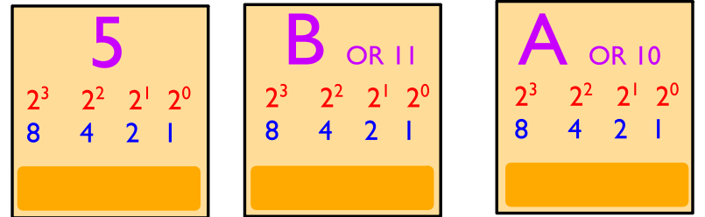
5BA to Binary
0 1 0 1
1 0 1 1
1 0 1 0
We use Hex because its easier for humans to read and for a computer to convert hex into binary then denary into binary

Slide 29
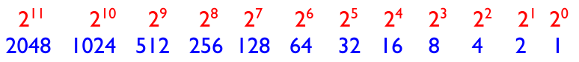
Then convert that binary like before
0 1 0 1 1 0 1 1 1 0 1 0
1024 + 256 + 128 + 32 + 16 + 8 + 2 = 1466
So
5BA = 0101 1011 1010 = 1466

Slide 30
Task
Get some paper
Write down any hex number on it
Give it to someone
That person must convert your hex into binary and denary.
No calculators

Slide 31
Decimal to Hex
Convert 456 into Hex
You must divide
256 / 456 = 1 remainder of 200
16 / 200 = 12 remainder of 8
1 / 8 = 8 remainder of 0
12 8
1 C 8

Slide 32
Decimal to Hex
Easier Way.
Decimal to binary
Binary to Hex
Remember each hex digit is 4 binary bits long

Slide 33
97
What is 97 decimal in Hex?
Find the binary
0 1 1 0 0 0 0 1

Slide 34
97
Now remember every hex digit is 4 binary bits long
0 1 1 0 0 0 0 1

Slide 35
97
And now just convert like normal
0 1 1 0 0 0 0 1
0 1 1 0
0 0 0 1
61

Slide 36
Decimal to hex
50 (decimal) to hex
50 in binary is:
0 0 1 1 0 0 1 0
Then take this number and split it so its in four bits
0 0 1 1 and 0 0 1 0
0011 = 3
0010 = 2
50 (decimal) is 32 in hex

Slide 37
Where we use Hex?
Because hex is easy for humans to read and computers to convert – we use hex whenever we have a lot of things.
This laptop has 8GB of memory…how many bytes are that?
Its 8589934592 bytes –
eight billion, five hundred eighty nine million ,
nine hundred thirty four thousand , five hundred and ninety two

Slide 38
Where we use hex
Every byte in my computers memory has a name. It has 8589934592 names – one for each byte.
But instead of listing them as 1, 2, 3, 4, 5….
We use hex instead.
Why?
Well what is F in hex?
15
15 uses two bytes (1 and 5) but F uses just one byte to store
And like we saw before, hex is great to count big numbers

Slide 39
HTML colour
Another place we use hex is on websites
We use it for HTML colour codes
Every colour you see on a screen is a mixture of red, green and blue
It can range from 0 (nothing) to 255 (the maximum amount)
So pure red will have 255 red, 0 green, 0 blue

Slide 40
So what?
Well, because we have many colours and many colour combinations – we use hex
HTML colour codes all start with a #
The first two characters say how much red, the next two is how much green and the next two how much blue
So pure red will be:
#FF0000

Slide 41
Task
What colour is this:
#00FF00
#FF00FF
#0000FF
#FFFFFF
#000000
Find 15 different colour codes

Slide 42
MAC Address
Another place where we use hex is something called MAC address.
Everything that connects to the internet (everything – phone, tablet, PC, fridge, TV, shower…) has a unique number – so you know what device is what.
No two devices in the world have the same number
This number is called the MAC (Media Access Control) number.
This number is 6 pairs of hex digits – 23-AC-F7-88-0E-B1
You can use ipconfig to see your MAC address/ or check out the address on your phone

Slide 43
Today
Add two positive 8-bit binary integers
Understand the concept of overflow and why it occurs in binary addition
8. Use two’s complement to represent positive and negative 8-bit binary integers
Understand: What is a binary shift
Able: Add binary numbers
Answer: How can we represent negative numbers?

Slide 44
Question
Using 4 bits, in Binary, what is decimal 5?
0011
Oh, you feel smart huh, okay…. What is negative 3 (-3) ?
You cannot have -0011 because there is no ”-” symbol in binary, all we have is 0 and 1.
So, there are 3 ways we deal with negative numbers. The first two ways are stupid, but the third way is the one we use. But we should know all 3 ways.
Signed Magnitude (Very stupid way)
One’s Complement (Still stupid)
Two’s Complement (it’s okay)

Slide 45

Binary Addition
Before we do the 2 stupid ways and one okay way, we need to know how to add in binary.

Slide 46
Binary Addition
0 + 0 = 0 (decimal 0)
0 + 1 = 1 (decimal 1)
1 + 0 = 1 (decimal 1)
1 + 1 = 0 carry 1 (decimal 2)
1 + 1 + 1 = 1 carry 1 (decimal 3)
Why for decimal 2, which is written as 1 0 in Binary, why do I use the 0 and carry the 1 and not use 1 and carry the 0.
You do the same for decimal addition 5 + 7 = 12 But if you was to write it, you would do:
 | 5
 | 7
1 | 2

Slide 47
Negative Numbers
Lets go back and look at the three ways to use negative numbers.
Signed Magnitude (Very stupid way)
One’s Complement (Still stupid)
Two’s Complement (it’s okay)

Slide 48
Signed Magnitude
Signed Magnitude is the simplest method. But it doesn’t work.
It takes the most significant bit (which is always the one on the left) and it says:
“If the bit on the left is 0 then everything else is positive. If the bit on the left is a 1, then everything else is negative”
So
0 | 0 | 1 | 1 | Standard Binary positive 3
0 | 0 | 1 | 1 | Signed Magnitude positive 3
1 | 0 | 1 | 1 | Signed Magnitude negative 3

Slide 49
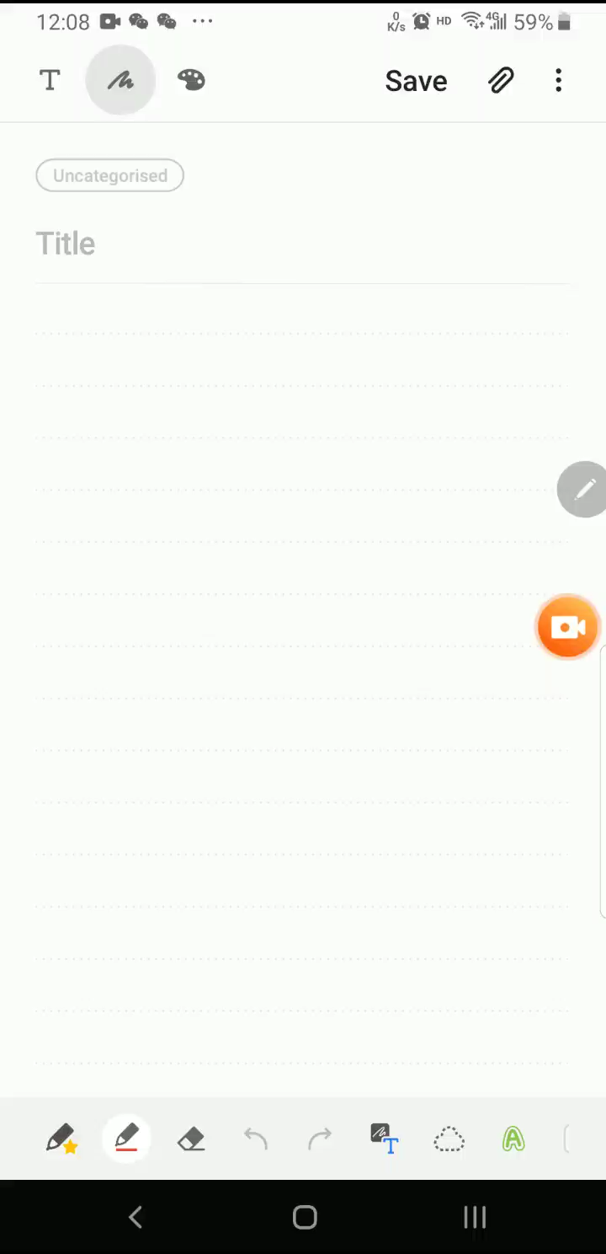
So why is Signed Magnitude stupid?
So in Signed Magnitude,
Positive 3 = 0011
Negative 3 = 1011
So lets add positive 3 with negative 3.
Our answer should be neutral 0

Slide 50
That’s why signed magnitude is stupid
Binary | Signed Magnitude
Base 2 | Base 10
0000 | 0
0001 | 1
0010 | 2
0011 | 3
0100 | 4
0101 | 5
0110 | 6
0111 | 7
1000 | -0
1001 | -1
1010 | -2
1011 | -3
1100 | -4
1101 | -5
1110 | -6
1111 | -7
Because it doesn’t work!
It’s a simple idea: The bit on the left is your signed bit
0 = positive
1 = negative
But when you add numbers together it fails.
AND have a look at the table.
There are two 0’s. Positive 0 (0000) and negative 0 (1000)

Slide 51
One’s Complement
So another method was made, called One’s Complement.
It’s a way to find out a negative number.
You know if it’s a negative number because the sign bit (the bit on the left, if it’s a 0 then positive and if its 1 then its negative)
Find the positive
Flip the 0’s and 1’s and that’s the negative version
So positive 3 = 0 0 1 1
Flip it = 1 1 0 0 That’s negative 3 in one’s complement
Again
Positive 5 = 0 1 0 1
Flip it = 1 0 1 0 That’s negative 5 in one’s complement

Slide 52
One’s Complement
Binary | Denary | Binary | Denary
Base 2 |  | One’s Complement
0000 | 0 | 1111 | -0
0001 | 1 | 1110 | -1
0010 | 2 | 1101 | -2
0011 | 3 | 1100 | -3
0100 | 4 | 1011 | -4
0101 | 5 | 1010 | -5
0110 | 6 | 1001 | -6
0111 | 7 | 1000 | -7
1000 | 8 | 0111 | 7
1001 | 9 | 0110 | 6
1010 | 10 | 0101 | 5
1011 | 11 | 0100 | 4
1100 | 12 | 0011 | 3
1101 | 13 | 0010 | 2
1110 | 14 | 0001 | 1
1111 | 15 | 0000 | 0
Because lets say positive 1 = 0 0 0 1 Flip it to find the negative 1 = 1 1 1 0
So we can find -1 as one’s complement.
What about 0 then?
Normal 0 is 0 0 0 0
Flip it and its 1 1 1 1
0000 in one’s complement is positive 0 decimal
But we already have 1111 in one’s complement which is negative 0
We still have +0 and -0

Slide 53
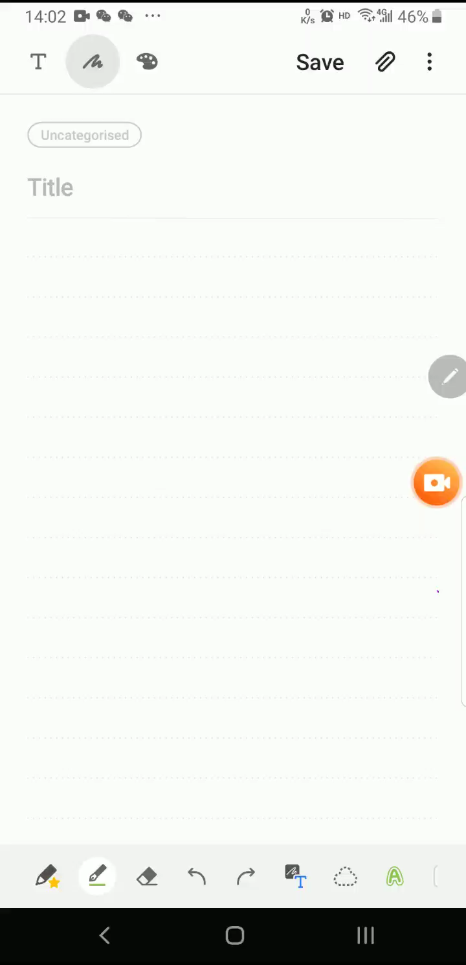
One’s Complement
Let’s do our example: positive 3 plus negative 3 to equal neutral 0
So no matter what we do, one’s complement is wrong
If we keep our answer in one’s complement it becomes negative 0. There is no such thing
If we switch it back to signed magnitude then its negative 7. Not even close to our answer

Slide 54
Two’s Complement
So another method to find negative numbers was made.
Two’s Complement
Find the positive
Flip the values
Add 0 0 0 1
Part (a) and (b) are the same as one’s complement, we are now just adding 1
Example: Positive 6 = 0 1 1 0
Flip it = 1 0 0 1
Add 0001 = 0 0 0 1
Answer = 1 0 1 0
So negative 6 in two’s complement is 1 0 1 0

Slide 55
Two complement
Binary | Denary | Binary | Denary | Binary | Denary
Base 2 |  | One’s Complement |  | Two’s Complement
0000 | 0 | 1111 | -0 | 10000 | 0
0001 | 1 | 1110 | -1 | 1111 | -1
0010 | 2 | 1101 | -2 | 1110 | -2
0011 | 3 | 1100 | -3 | 1101 | -3
0100 | 4 | 1011 | -4 | 1100 | -4
0101 | 5 | 1010 | -5 | 1011 | -5
0110 | 6 | 1001 | -6 | 1010 | -6
0111 | 7 | 1000 | -7 | 1001 | -7
1000 | 8 | 0111 | 7 | 1000 | -8
1001 | 9 | 0110 | 6 | 0111 | 7
1010 | 10 | 0101 | 5 | 0110 | 6
1011 | 11 | 0100 | 4 | 0101 | 5
1100 | 12 | 0011 | 3 | 0100 | 4
1101 | 13 | 0010 | 2 | 0011 | 3
1110 | 14 | 0001 | 1 | 0010 | 2
1111 | 15 | 0000 | 0 | 0001 | 1
So here you can see we take the original binary, flip it to get One’s complement and then add 1 to get Two’s complement.
We only have one 0
Which is 1 0 0 0 0
But this has an extra 1, we will deal with this soon.

Slide 56
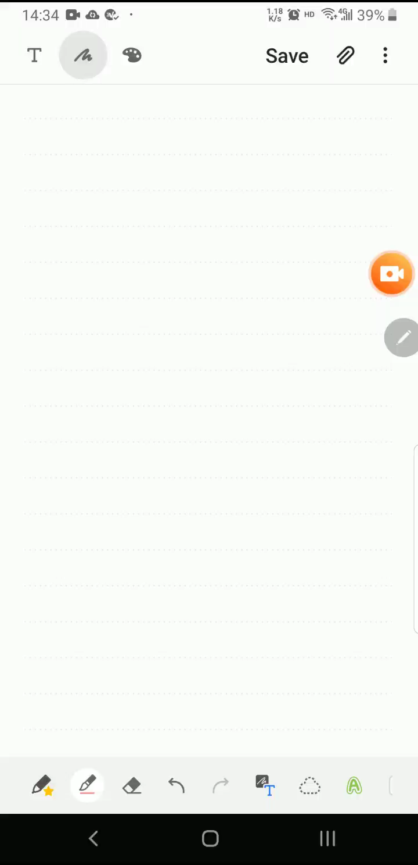
Let’s try our addition
Positive 3 add Negative 3
Find positive 3 0 0 1 1
Flip it 1 1 0 0
Add 0001 0 0 0 1
So -3 in 2C is 1 1 0 1
Now just do the math
Positive 3 0 0 1 1
Two Comp -3 1 1 0 1
Answer 1 0 0 0 0
We will deal with that extra ‘1’ in a moment

Slide 57
That extra 1 on the left
So our answer is:
Positive 3 0 0 1 1
Two Compliment -3 1 1 0 1
Answer 1 0 0 0 0
But it has an extra 1 on the left.
We are only using 4 bits, but our answer has 5 bits.
We remove this extra 1 on the left and just keep the four zeros. So 1 0 0 0 0 becomes 0 0 0 0
This extra 1, this is called our OVERFLOW.

Slide 58
Today
7. Perform a logical binary shift on a positive 8-bit binary integer and understand the effect this has on the positive binary integer
Understand: What is meant by bit shift
Able: Know the difference between left and right bit shift
Answer: How does bit shift affect multilocation?

Slide 59
Bit Shift
Ahh, the joy of Computer Science…. Something so simple given a stupid name so that it sounds smart.
Bit Shift.
Bit shift just means moving a binary number.
Left bit shift means moving it to the left
Right bit shift means moving it to the right
Okay, lesson finished, thanks, bye.
No no no…… wtf do you mean moving the number?

Slide 60
Left Bit shift
Lets start with a random binary number 00010101
 |  | 2⁷ | 2⁶ | 2⁵ | 2⁴ | 2³ | 2² | 2¹ | 2⁰
 |  | 128 | 64 | 32 | 16 | 8 | 4 | 2 | 1
Original (Decimal 21) |  | 0 | 0 | 0 | 1 | 0 | 1 | 0 | 1
Now we move that number to the left | 0 | 0 | 0 | 1 | 0 | 1 | 0 | 1
But now we have a problem, we have an extra 0 on the left and an empty space on the right
We just forget about the extra 0 on the left, this is OVERFLOW. And we just fill in the empty space with a 0.
 |  | 0 | 0 | 1 | 0 | 1 | 0 | 1 | 0
What’s this number in decimal?
42. Its double of our original number
That is left bit shift. We moved our number to the left by 1 space. So it’s a 1 bit left bit shift

Slide 61
Left Bit Shift
Every time you left bit shift, you multiply your answer by 2. Lets do another example
Task:
Original number is 0 0 0 1 1 0 0 0
Perform 2 left bit shifts
 |  | 2⁷ | 2⁶ | 2⁵ | 2⁴ | 2³ | 2² | 2¹ | 2⁰
 |  | 128 | 64 | 32 | 16 | 8 | 4 | 2 | 1
Original (Decimal 7) |  | 0 | 0 | 0 | 0 | 0 | 1 | 1 | 1
Now we move that number to the left | 0 | 0 | 0 | 0 | 0 | 1 | 1 | 1
Remove the overflow and fill in the gap with a 0
 |  | 0 | 0 | 0 | 0 | 1 | 1 | 1 | 0
What’s this number in decimal?
14. Its double of our original number

Slide 62
Left Bit Shift
Every time you left bit shift, you multiply your answer by 2.
 |  | 2⁷ | 2⁶ | 2⁵ | 2⁴ | 2³ | 2² | 2¹ | 2⁰
 |  | 128 | 64 | 32 | 16 | 8 | 4 | 2 | 1
Original (Decimal 24) |  | 0 | 0 | 0 | 1 | 1 | 0 | 0 | 0
Now we move that number to the left | 0 | 0 | 0 | 1 | 1 | 0 | 0 | 0
Remove the overflow and fill in the gap with a 0
1 left bit shift gives us decimal 48 |  | 0 | 0 | 1 | 1 | 0 | 0 | 0 | 0
But I asked for 2 left bit shift, so we just repeat
So we now have 48 |  | 0 | 0 | 1 | 1 | 0 | 0 | 0 | 0
Now we move that number to the left | 0 | 0 | 1 | 1 | 0 | 0 | 0 | 0
Remove the overflow and fill in the gap with a 0
Gives us 96. Which is double of 48 |  | 0 | 1 | 1 | 0 | 0 | 0 | 0 | 0

Slide 63
Right Bit Shift
If left bit shift means moving the number to the left, what do you think right bit shift means?
Yeah, it means you move the number to the right
If left bit shift means you double each time, what do you think right bit shift does?
Yep, it means you half (divide) each time

Slide 64
Right Shift Bit example
0 0 0 1 1 1 1 0
 | 2⁷ | 2⁶ | 2⁵ | 2⁴ | 2³ | 2² | 2¹ | 2⁰
 | 128 | 64 | 32 | 16 | 8 | 4 | 2 | 1
Original (Decimal 30) | 0 | 0 | 0 | 1 | 1 | 1 | 1 | 0
Now we move that number to the RIGHT |  | 0 | 0 | 0 | 1 | 1 | 1 | 1 | 0
But now we have a problem, we have an extra digit on the right and an empty gap on the left
We just forget about the extra digit, this is Underflow. And we just fill in the empty space with a 0.
 | 0 | 0 | 0 | 0 | 1 | 1 | 1 | 1
What’s this number in decimal?
15. Its half of our original number
That is right bit shift. We moved our number to the right by 1 space. So it’s a 1 bit right bit shift

Slide 65
Another Example - 0 0 0 0 0 1 0 1
 | 2⁷ | 2⁶ | 2⁵ | 2⁴ | 2³ | 2² | 2¹ | 2⁰
 | 128 | 64 | 32 | 16 | 8 | 4 | 2 | 1
Original (Decimal 5) | 0 | 0 | 0 | 0 | 0 | 1 | 0 | 1
Now we move that number to the RIGHT |  | 0 | 0 | 0 | 0 | 0 | 1 | 0 | 1
But now we have a problem, we have an extra digit on the right and an empty gap on the left
We just forget about the extra digit. And we just fill in the empty space with a 0.
 | 0 | 0 | 0 | 0 | 0 | 0 | 1 | 0
What’s this number in decimal?
2. BUT BUT BUT…. Our original number was 5, we know right shift bit means you divide in half. So half of 5 should be 2.5, but our answer is just 2. WTF. This is called UNDERFLOW. When a number is too small to be represented. There are two ways to solve this, Fixed pointed and Floating point. We do this in Year 13

Slide 66
Summary
Bit shift = moving a binary number
Left bit shift = Moving the number to the left.
Each Left bit shift multiplies your number by 2
Right shift bit = Moving the number to the right
Each Right bit shift divides your number by 2
Overflow = When a digit has no space to fit on the left
Underflow = When a digit has no space to fit on the right
Some new terms:
Most significant bit
Least significant bit

Slide 67
Most significant bit & Least significant bit
Most significant bit (MSB) means the first bit on the left
Least significant bit (LSB) means the last bit on the right
Green is MSB
Orange is LSB
2⁷ | 2⁶ | 2⁵ | 2⁴ | 2³ | 2² | 2¹ | 2⁰
128 | 64 | 32 | 16 | 8 | 4 | 2 | 1
1 | 0 | 0 | 0 | 1 | 1 | 0 | 1
0 | 1 | 1 | 1 | 1 | 1 | 1 | 1
0 | 0 | 0 | 1 | 1 | 0 | 1 | 0

Slide 68
PROBLEM
In your syallabus there is NOTHING on Copyright, Freeware, Free Software……
But…. When you look at Past Paper questions those topics are there.
So, we will very quickly cover these topics because I don’t want you in an exam thinking WTF is copyright

Slide 69
Today
3. Show understanding of the need for copyright legislation
4. Show understanding of the different types of software licencing and justify the use of a licence for a given situation 7. Licences to include free Software Foundation, the Open Source Initiative, shareware and commercial software
Understand: What is copyright?
Able: Explain why we have different licences
Answer: What’s the difference between freeware and shareware?

Slide 70
The public good
The standards mainly relate to being professional.
But there is something called doing things for “The Public Good”
This is about:
Health and safety and welfare of the public
Public Interest
Public Good
Public Concern
Go and read page 103.

Slide 71
Ownership and Copyright
Copyright = Formal recognition of ownership
Ownership = If you create something that has an element of originality
Copyright applies to:
Literary work
Music
Film
Radio and TV
Art
Computer Program

Slide 72
Copyright
The reason for copyright are:
It takes time and effort to make something and you should be rewarded (with money) if someone uses whatever you made
It will be unfair if someone takes or uses your work without your permission

Slide 73
Assign copyright
To get copyright you’ll need:
Requirement for recording the date of creation of the work
How long the copyright will last for
What happens if one person has the copyright and they die?
How to show you have copyright. Usually the © Symbol

Slide 74
Ownership
Now you can make something and have ownership of it.
You can have copyright of your stuff
You can now decide how to share your stuff.
Two main ways
Commercial software
Open / Free licensing

Slide 75
Software licensing
Commercial Software:
Someone has to pay money for your software
Companies buy buy a site licence for a number of copies to be used at once
You can sell it cheaper for education use
Eerily versions can be cheaper
Limited versions can be cheaper

Slide 76
Software licensing
Open or Free licensing
Open source initiative = Open source software
Your software is given away for free WITH the source code. So someone else can edit your software and then distribute it again
Free software foundation = This has something called “copyleft” This means if your software is modified then it must be redistributed under the same conditions
You can also get freeware
Freeware = Free software but doesn’t include the source code

Slide 77
Terms
Open source software
Free software. Unlimited use and access to source code
Freeware
Free software. No source code
Shareware
Software is free but only for a limited time. No source code
Commercial:
You pay for it.

Slide 78
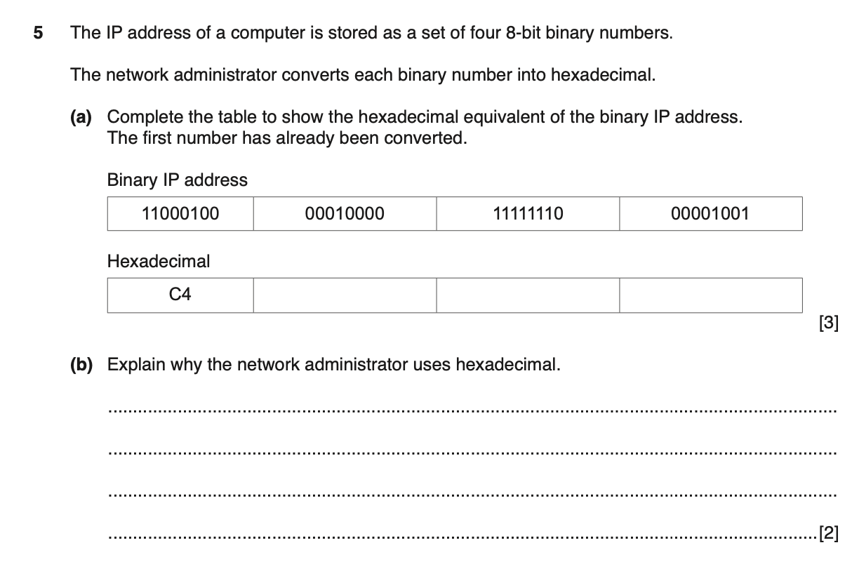
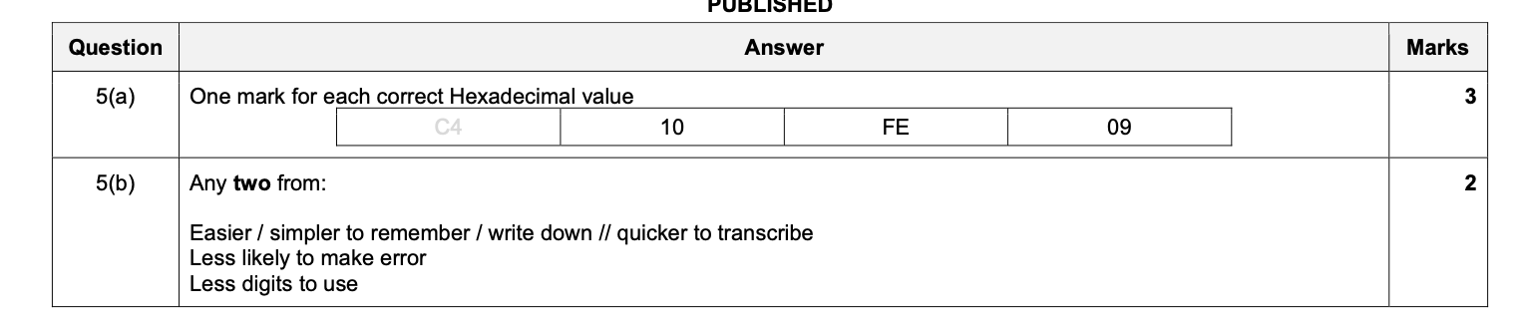

Slide 79
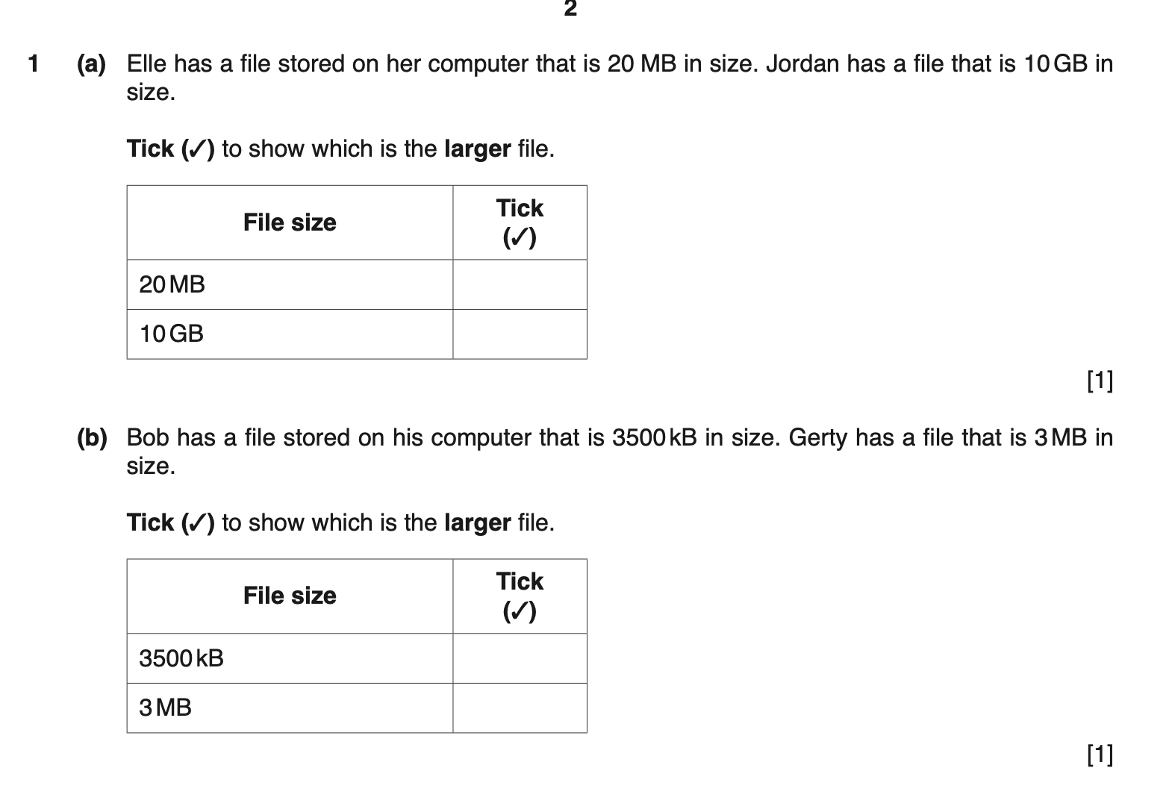
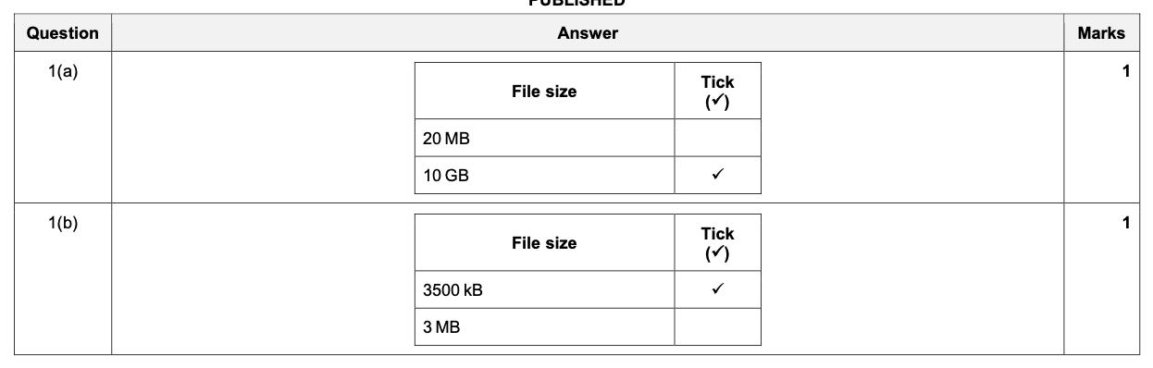

Slide 80
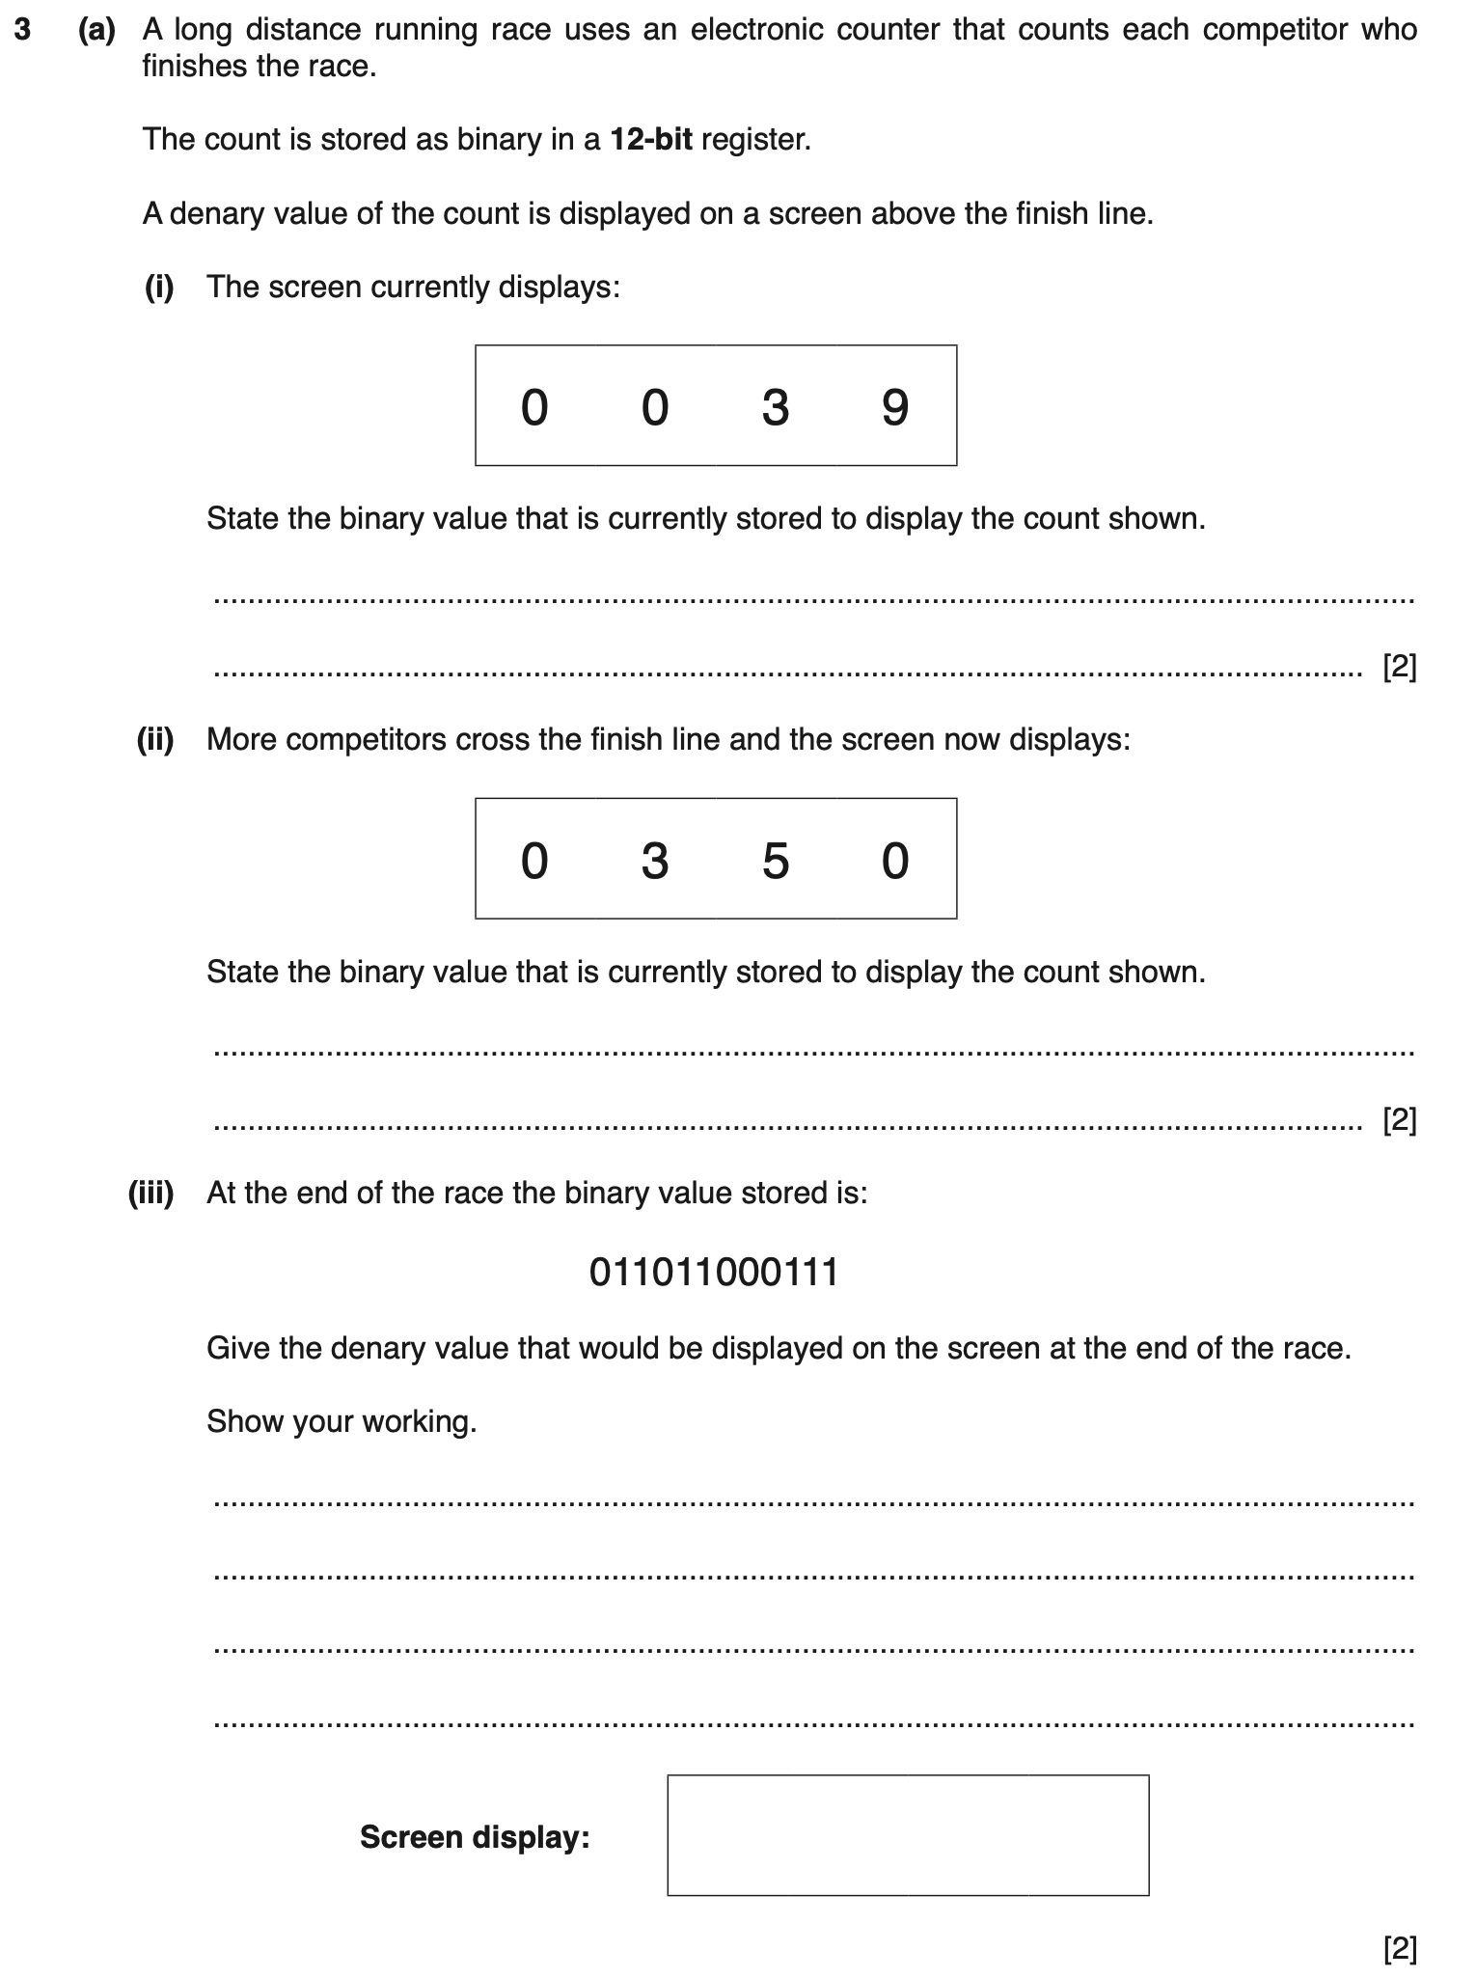
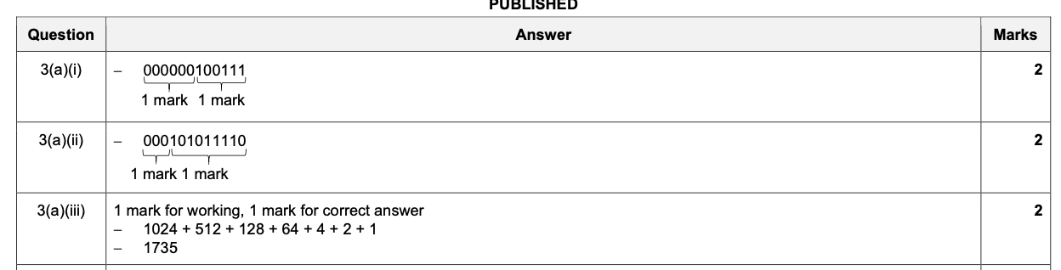

Slide 81
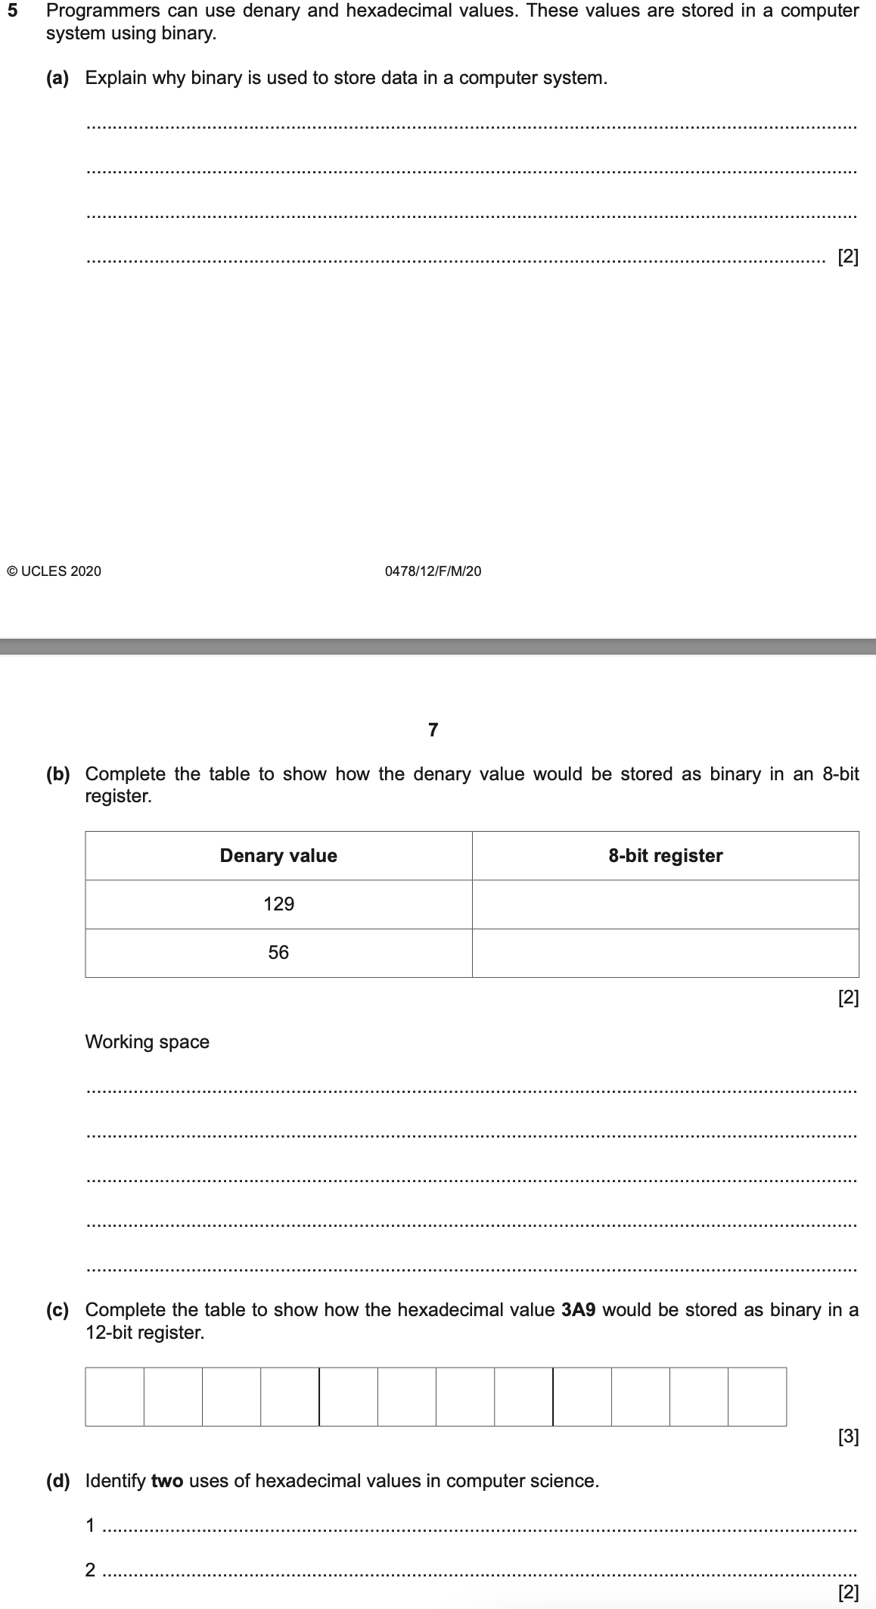
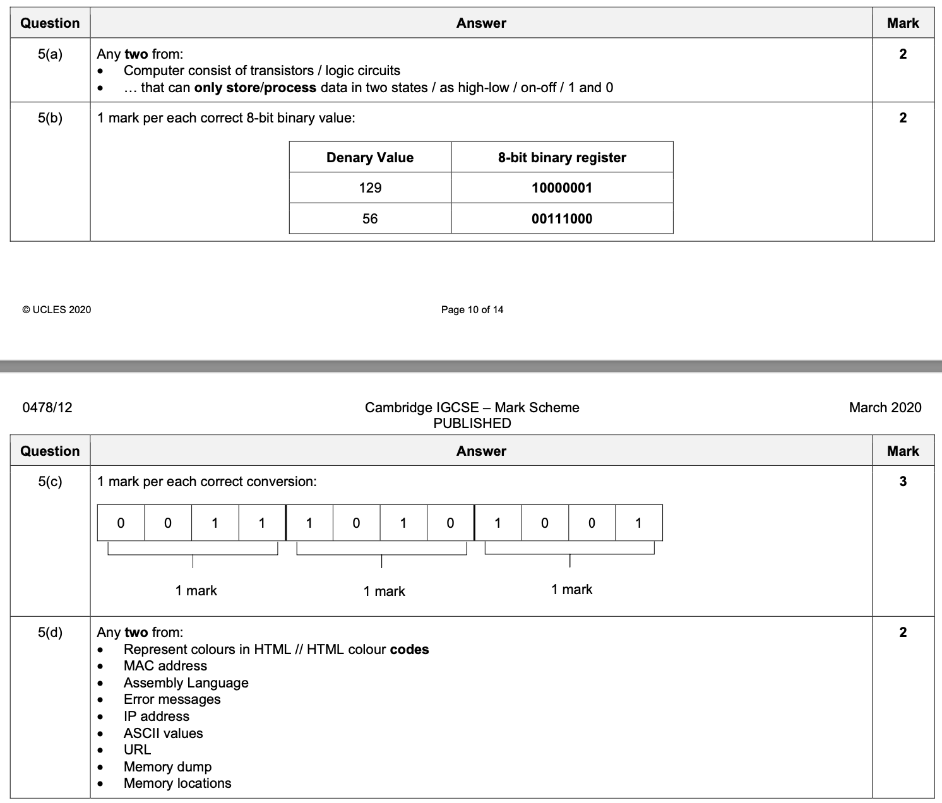

Slide 82
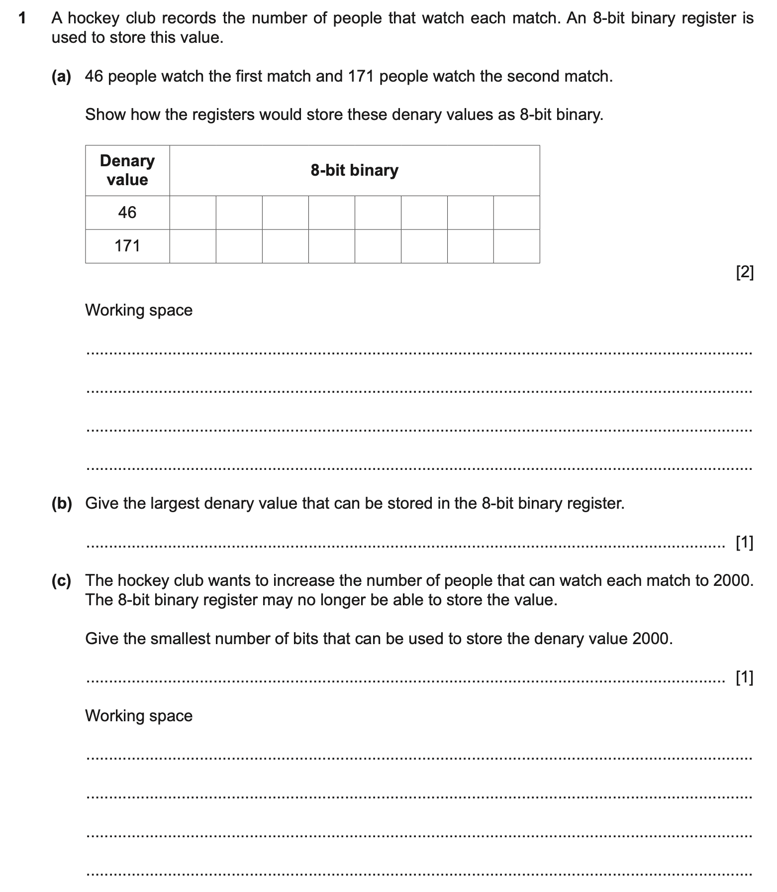
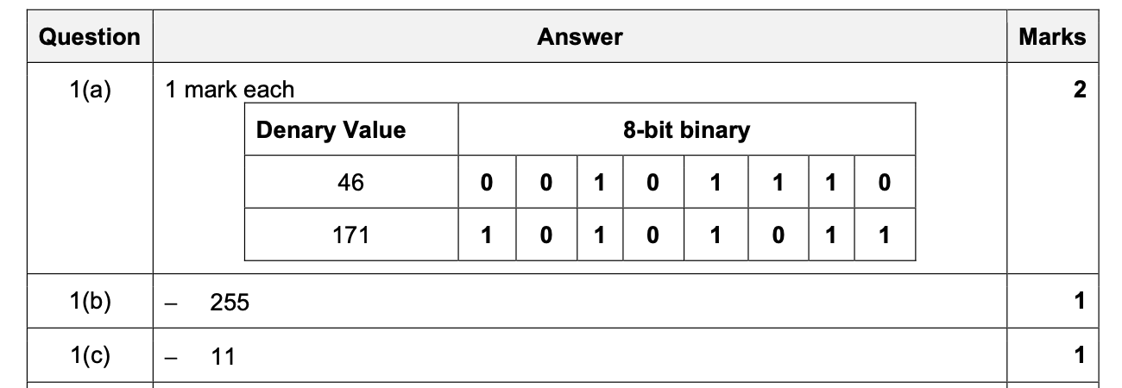

Slide 83
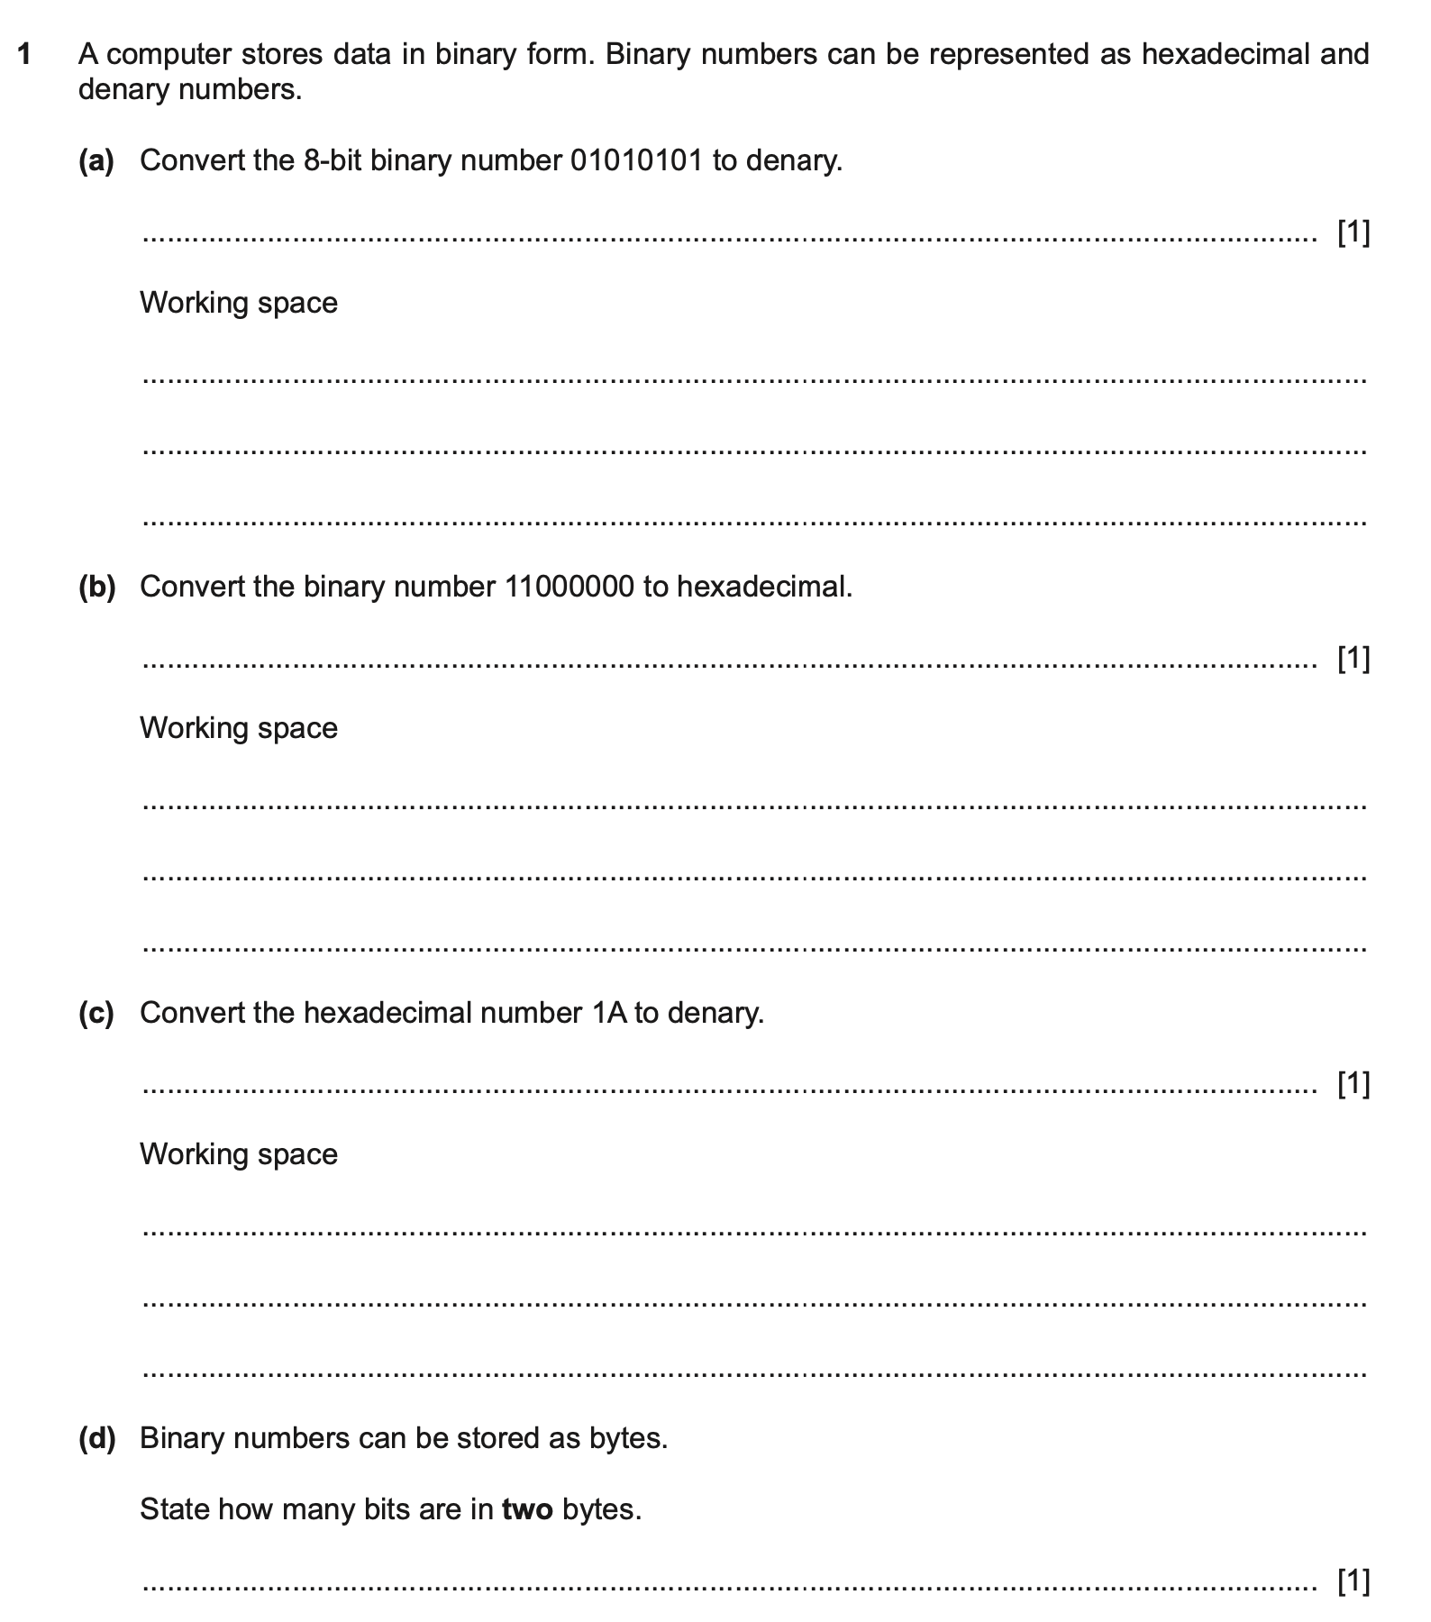
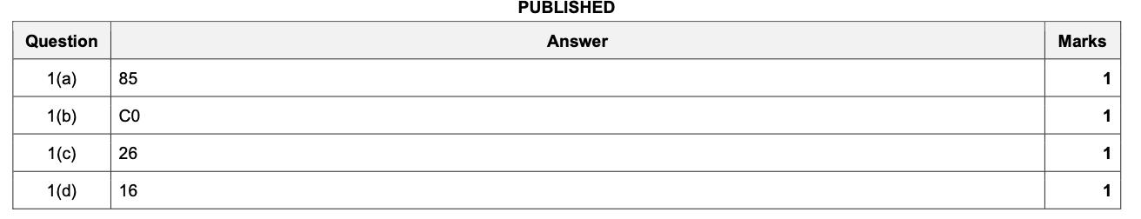

Slide 84
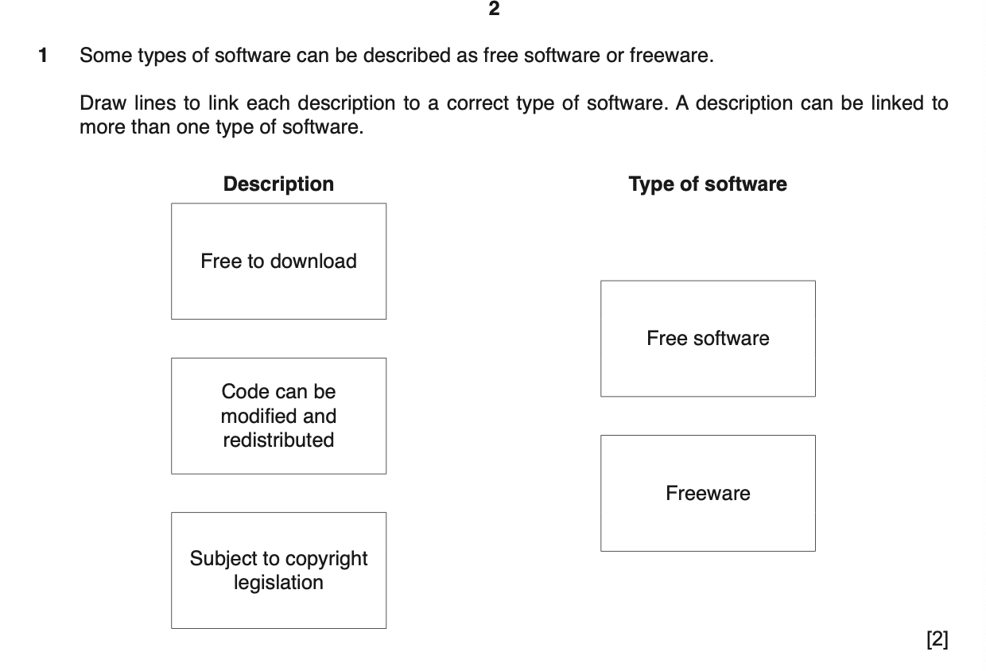
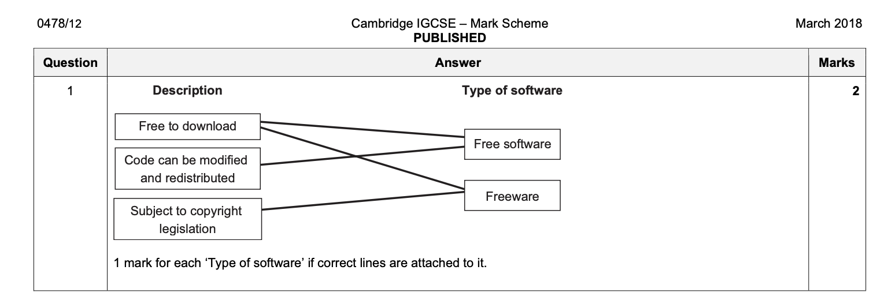

Slide 85
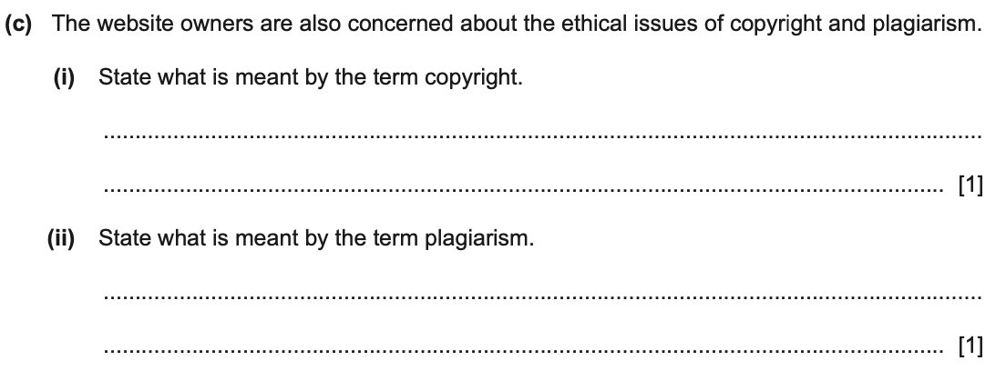
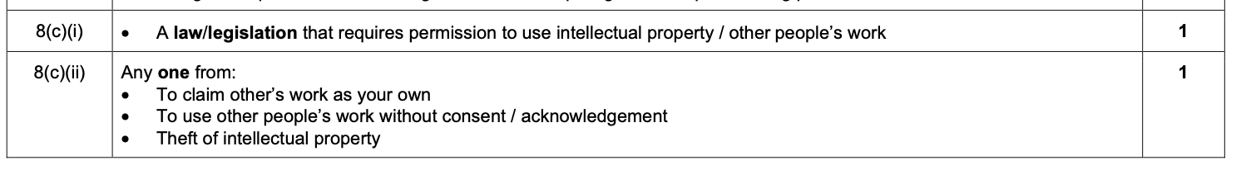

Slide 86
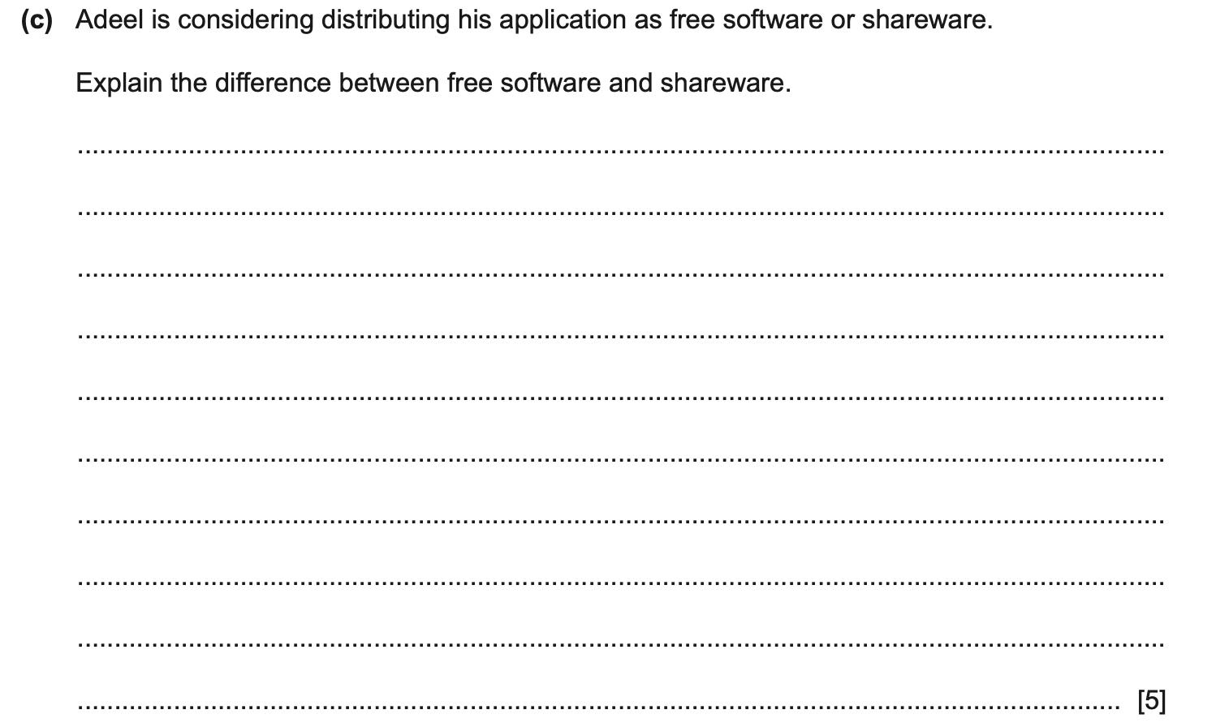
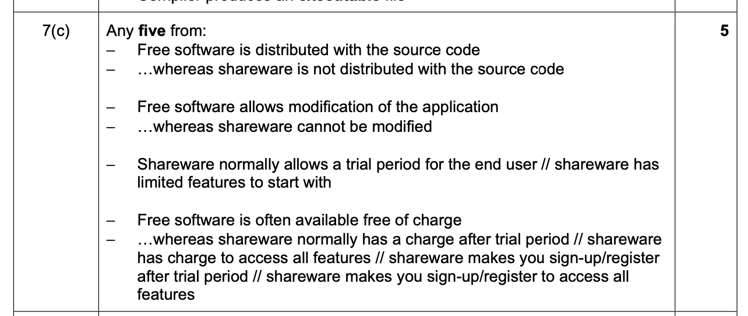

Slide 87
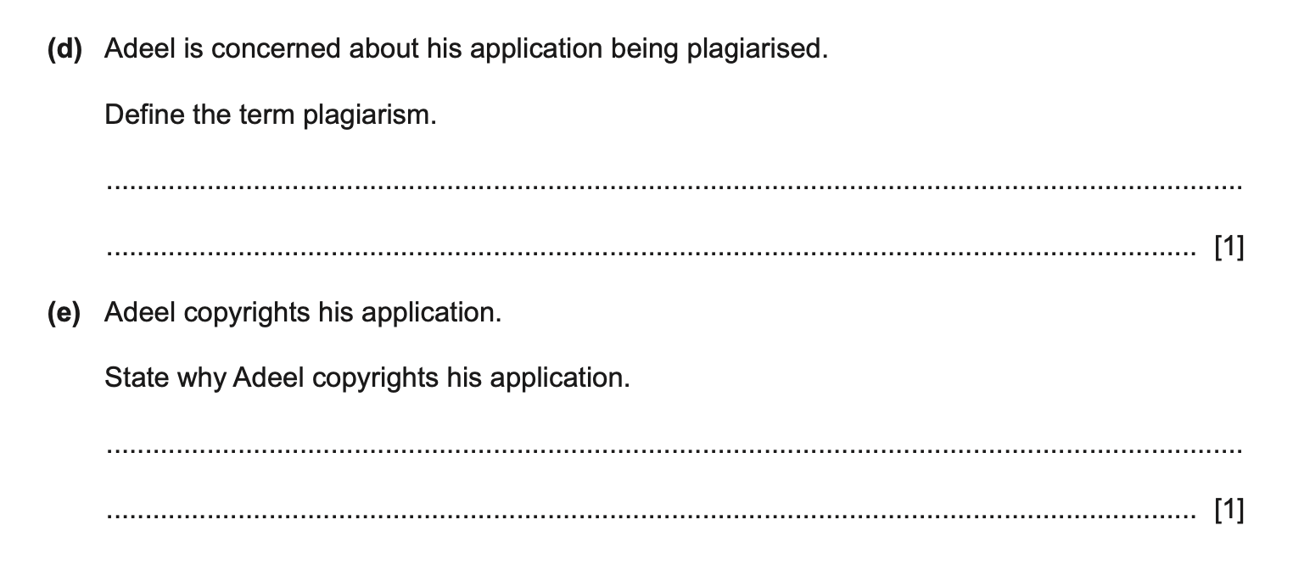
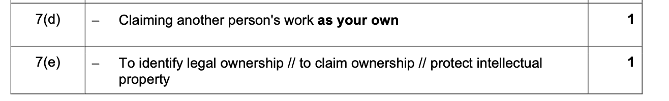

Slide 88
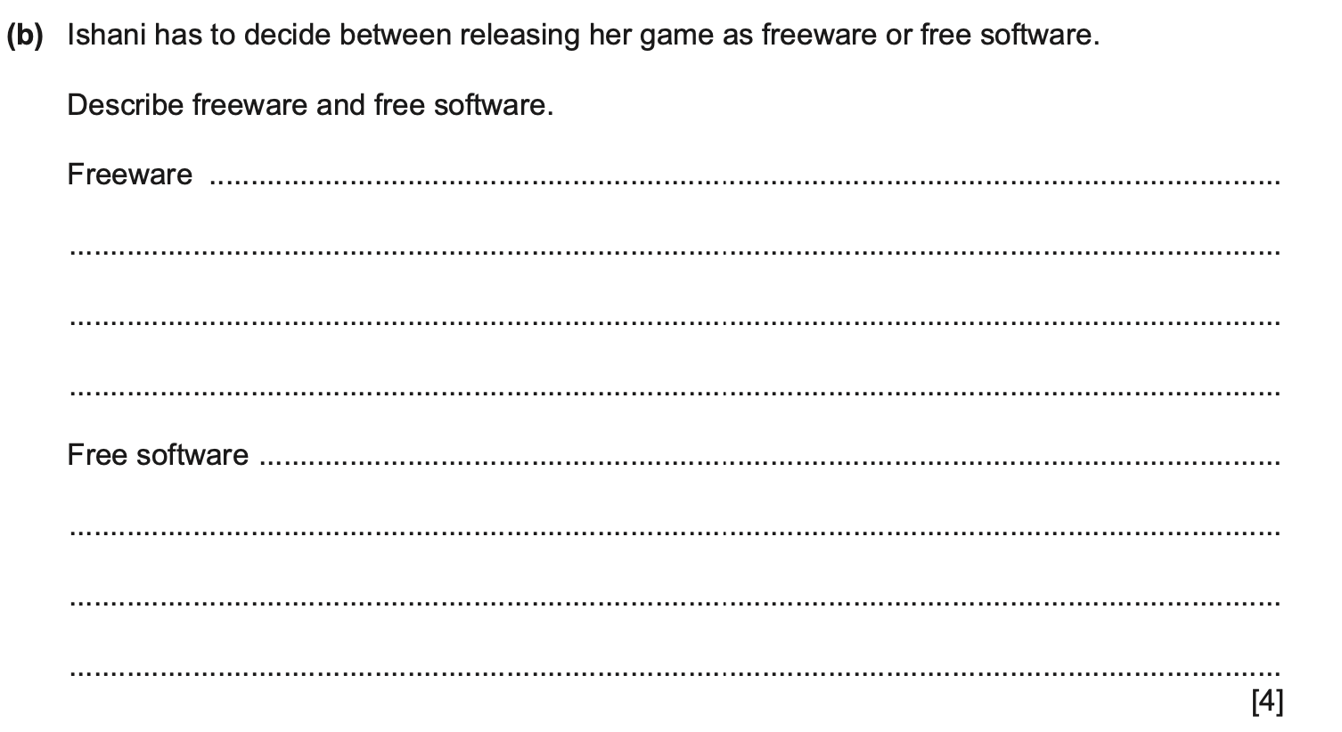
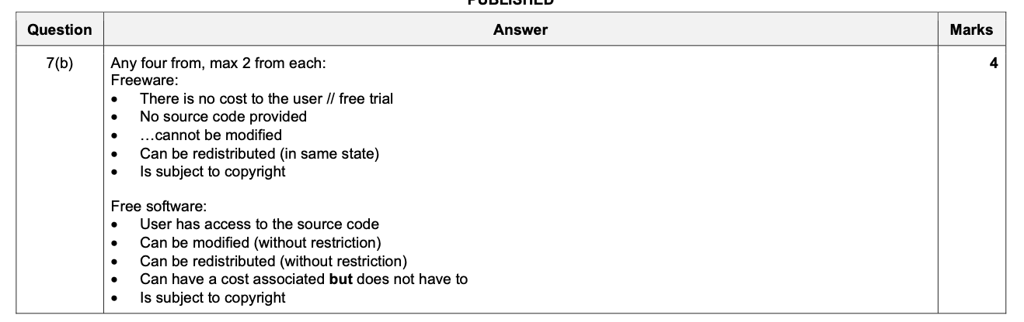

Slide 89
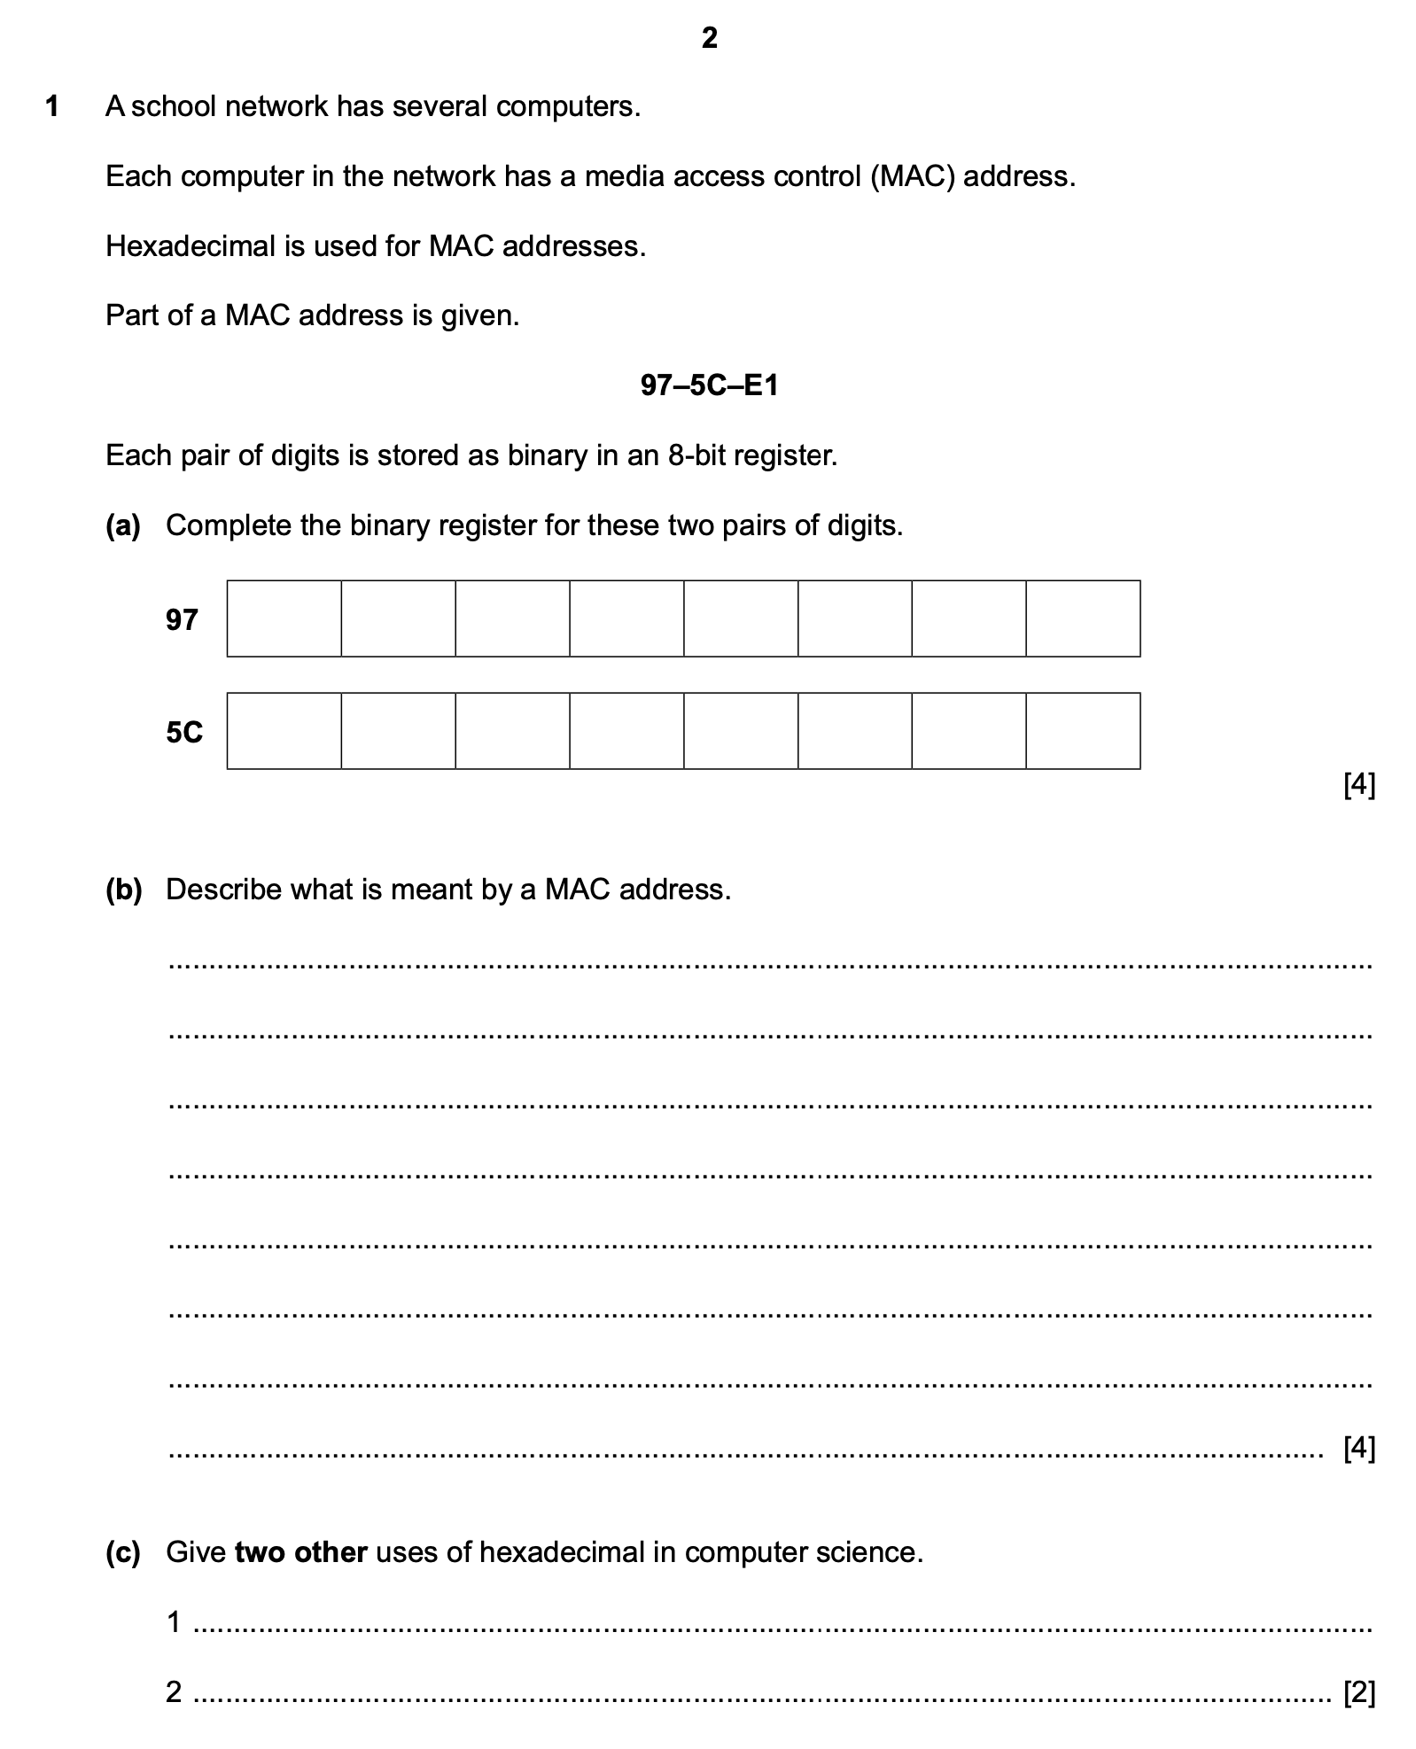
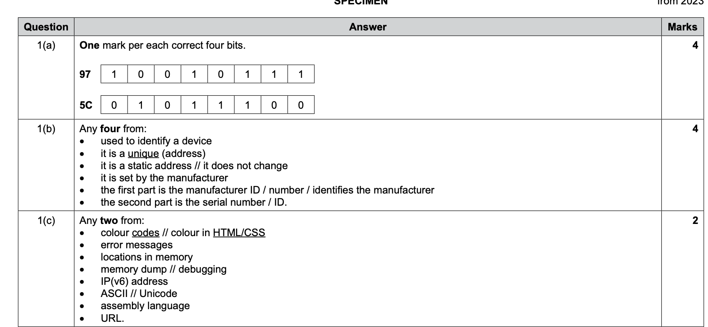

Slide 90
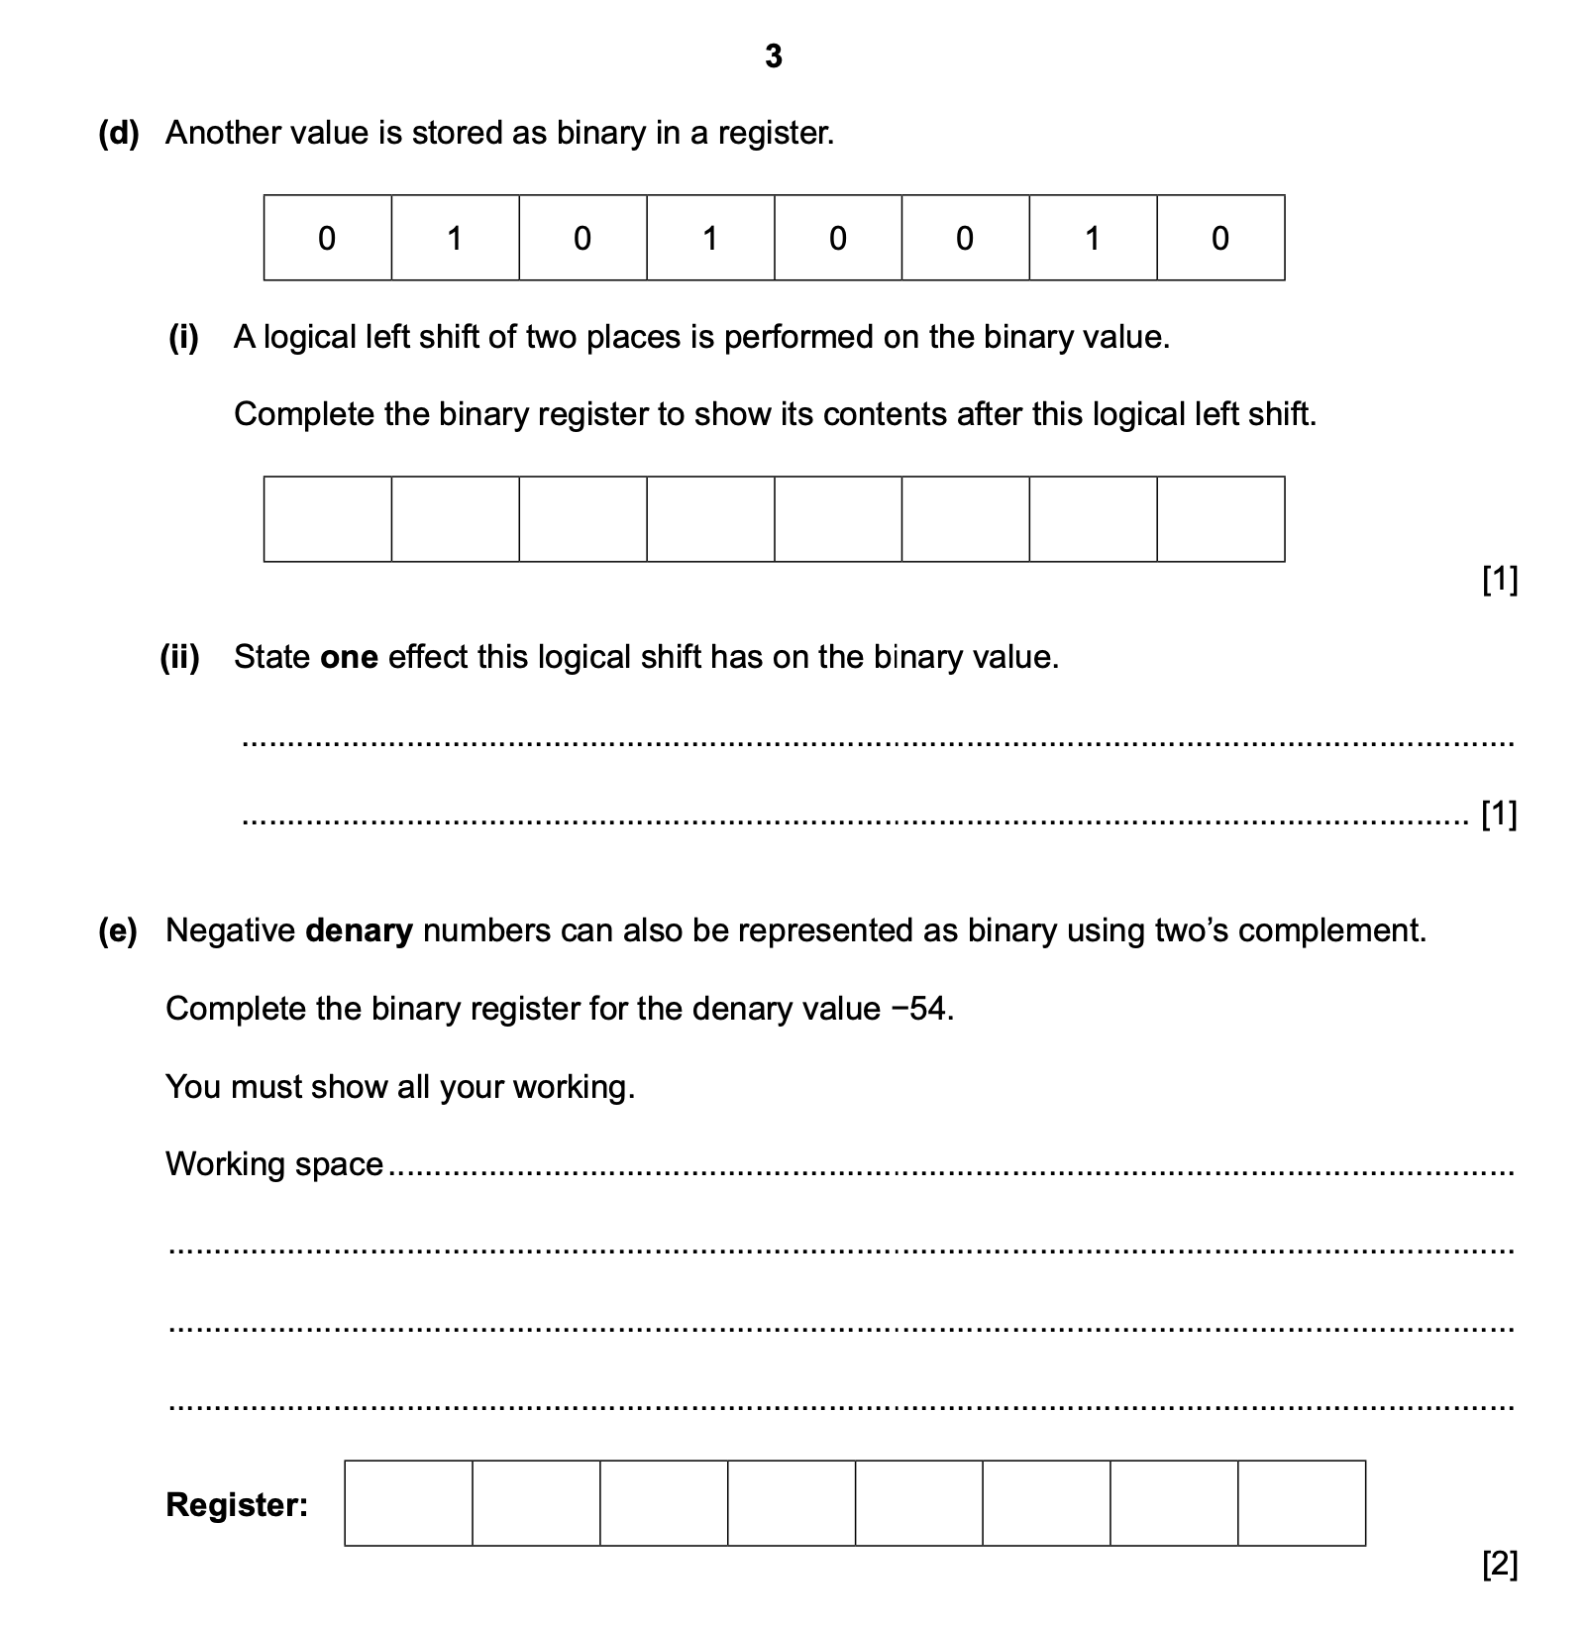
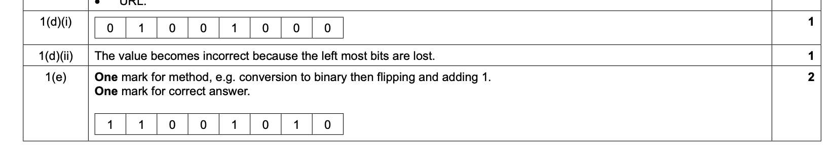

Slide 91
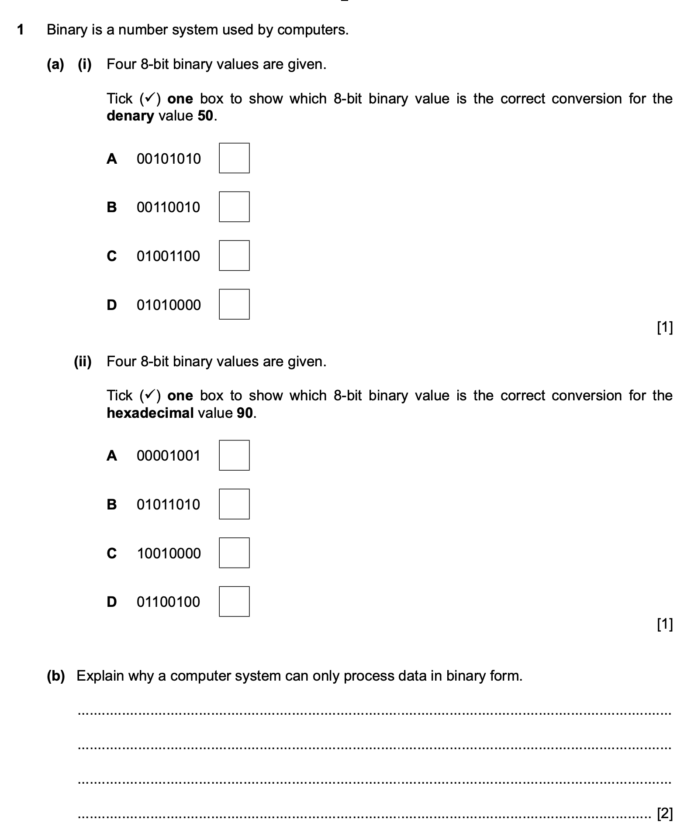
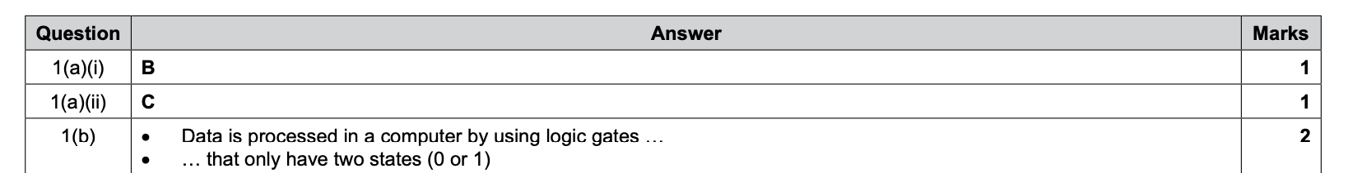

Slide 92
